Slide 1
Potential Energy Maps & Co-ordinate system
By
Mrs. Aparna Patil Kose
Lecturer
Dept of Bioinformatics

Slide 2
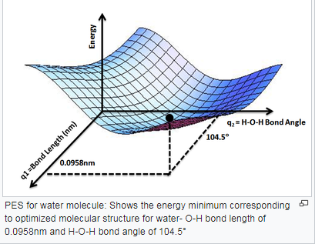
Potential energy maps
What is the potential energy of a molecule?
Ans: Potential energy related to the structural arrangement of atoms or molecules. This arrangement may be the result of chemical bonds within a molecule or otherwise.
What is meant by potential energy surface?
Ans: A potential energy surface (PES) describes the energy of a system, especially a collection of atoms, in terms of certain parameters, normally the positions of the atoms.
The surface might define the energy as a function of one or more coordinates.
It can be used to theoretically explore properties of structures composed of atoms, for example, finding the minimum energy shape of a molecule or computing the rates of a chemical reaction.

Slide 3
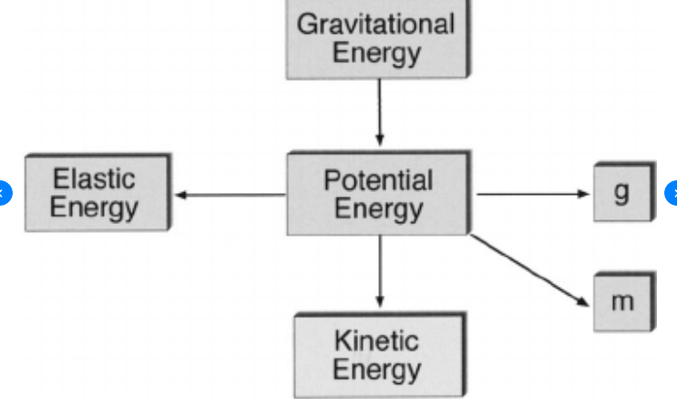
Electrostatic potential energy/Maps

Slide 4
Potential energy maps
Electrostatic potential maps, also known as electrostatic potential energy maps, or molecular electrical potential surfaces, illustrate the charge distributions of molecules three dimensionally.
These maps allow us to visualize variably charged regions of a molecule.
IMPORTANCE: Knowledge of the charge distributions can be used to determine how molecules interact with one another. Electrostatic potential maps are invaluable in predicting the behavior of complex molecules.
1st: In creating an EPM , important is to collect a very specific type of data: electrostatic potential energy.
An advanced computer program calculates the electrostatic potential energy at a set distance from the nuclei of the molecule.

Slide 5
EPM is fundamentally a measure of the strength of the nearby charges, nuclei and electrons, at a particular position.
To accurately analyze the charge distribution of a molecule, a very large quantity of electrostatic potential energy values must be calculated.
The best way to convey this data is to visually represent it, as in an electrostatic potential map.
A computer program then imposes the calculated data onto an electron density model of the molecule derived from the Schrödinger equation.
To make the electrostatic potential energy data easy to interpret, a color spectrum, with red as the lowest electrostatic potential energy value and blue as the highest, is employed to convey the varying intensities of the electrostatic potential energy values.

Slide 6
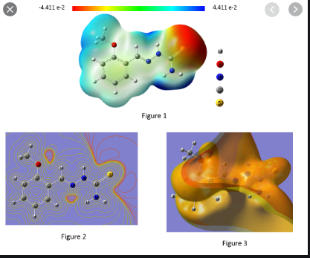
Figure.1=> Molecular Electrostatic Potential (MEP) surface, this is to locate the positive and negative charged electrostatic potential in the molecule.
In each MEP surface, has a color scale that indicates the negative and positive value. In the figure.1 you have red as negative extreme and blue as positive extreme. The red color with negative indicate the minimum electrostatic potential (that means it is bound loosely or excess electrons) and act as electrophilic attack. The blue indicate the maximum of electrostatic potential, and it acts opposite..
Figure.2=> In order to see all the MEP surfaces one can simply plot each surface as a contour around the molecule. Now look at the figure.2, the each contour curves around the molecule is MEP surface, the outer contour is with lower iso-surface value and inner contour is with higher iso-surface value. The explanation is as similar as Figure.1 for selected contour.
Figure.3=> It is entirely different from what has been plotted in the Figure.1 and Figure.2. However, it is just to correlate the same results that are drawn from the Figure.1 or Figure.2. This surface is to indicate the available unoccupied surface around the molecule where the excitation are going to reside around the molecule.
Ref: https://www.researchgate.net/post/How-to-interpret-a-map-of-electrostatic-potential-MEP

Slide 7
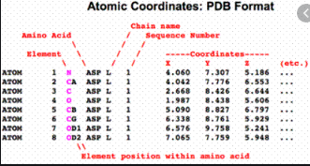
Co-ordinate systems
a coordinate system is a system that uses one or more numbers, or coordinates, to uniquely determine the position of the points or other geometric element.
In three-dimensional space, the Cartesian coordinate system is based on three mutually perpendicular coordinate axes: the x-axis, the y-axis, and the z-axis.
Ref: Cartesian coordinates: https://mathinsight.org/cartesian_coordinates

Slide 8
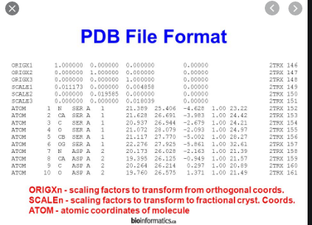
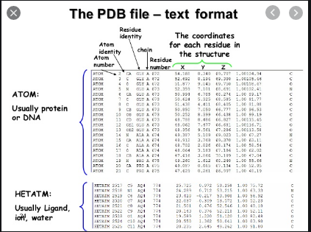

Slide 9
References
Electrostatic Potential maps/ Potential Energy Maps: https://chem.libretexts.org/Bookshelves/Physical_and_Theoretical_Chemistry_Textbook_Maps/Supplemental_Modules_(Physical_and_Theoretical_Chemistry)/Chemical_Bonding/Fundamentals_of_Chemical_Bonding/Electrostatic_Potential_maps#:~:text=Electrostatic%20potential%20maps%2C%20also%20known,charged%20regions%20of%20a%20molecule.
Cartesian coordinates: https://mathinsight.org/cartesian_coordinates
Coordinate System: http://biosiva.50webs.org/genomics.htm

